Slide 1
Decision Trees Regression Trees ECE 4740/5740 Professor Hanna

Slide 2
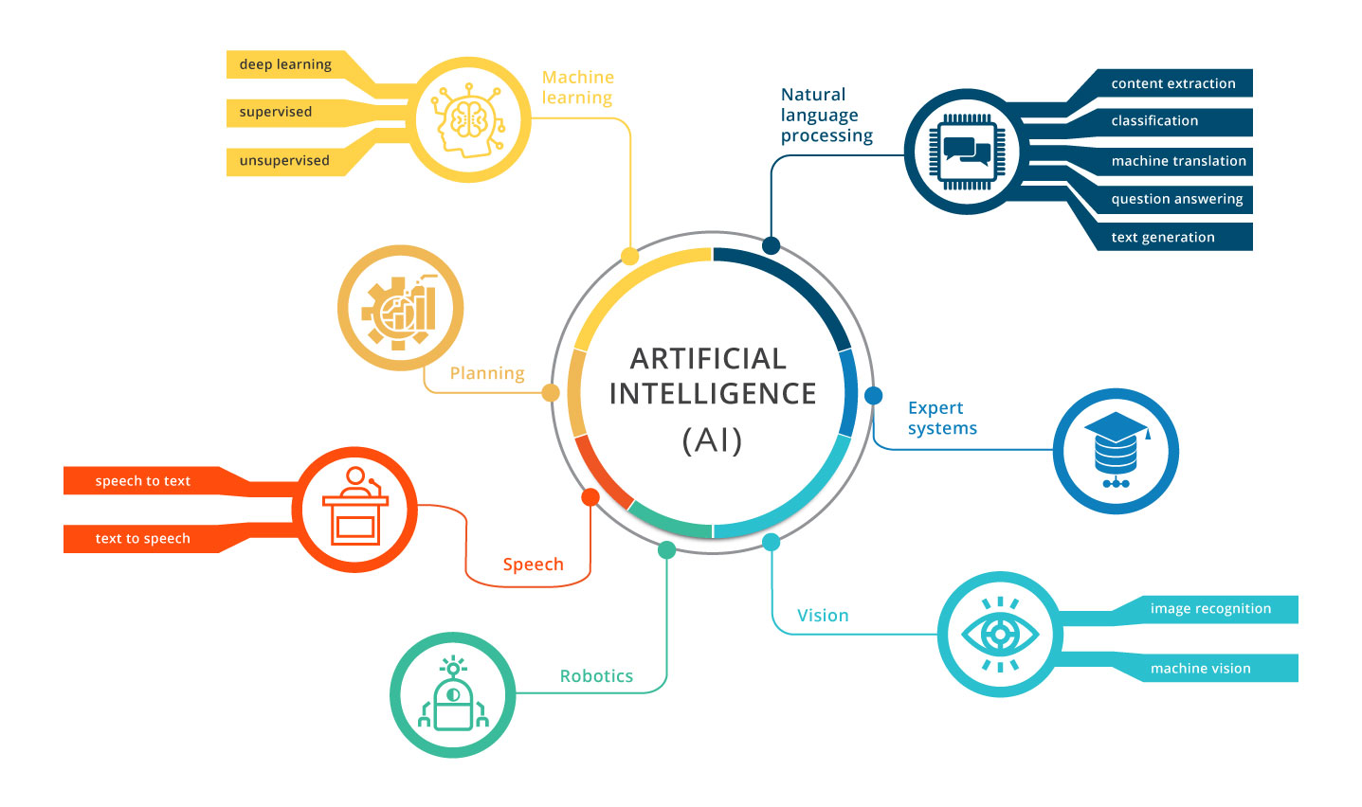
Artificial Intelligence

Slide 3
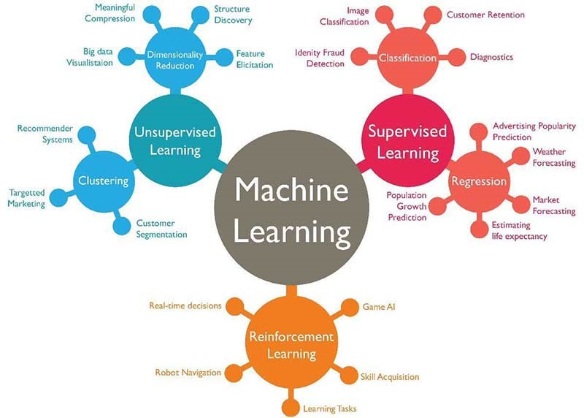
Machine Learning

Slide 4
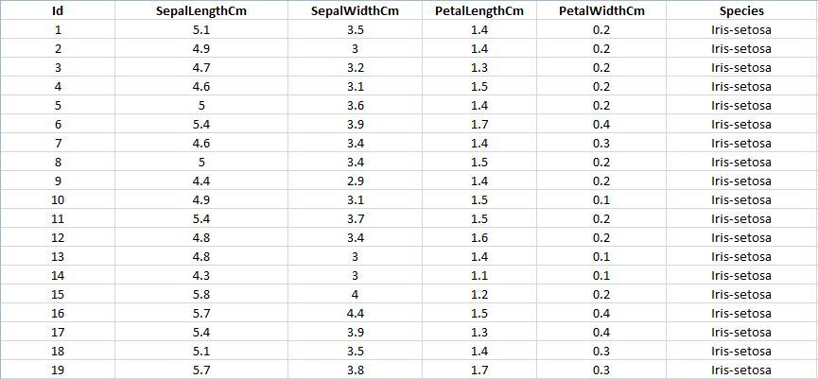
Supervised vs. Unsupervised Learning
Supervised Learning
Labeled data – Input and Output

Slide 5
Supervised vs. Unsupervised Training
Unsupervised Training
Unlabeled data
There are 3 different types of flowers

Slide 6
Supervised vs. Unsupervised Training
Supervised Training
Given Sepal Length, Sepal Width, Petal Length, and Petal Width, predict which of type or iris the test flower is {Iris Setosa, Iris Virginica, or Iris Versicolor} ?
Unsupervised Training
Given Sepal Length, Sepal Width, Petal Length, and Petal Width, predict which flower the test flower is closest to?

Slide 7
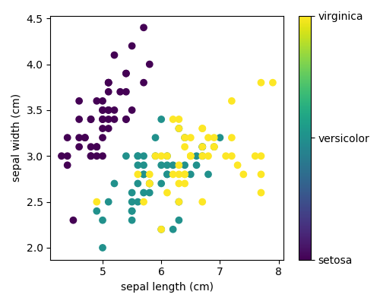
Supervised vs. Unsupervised Training
Supervised – Types are knowns, hence the colors
Unsupervised – All points would be black, types unknown

Slide 8
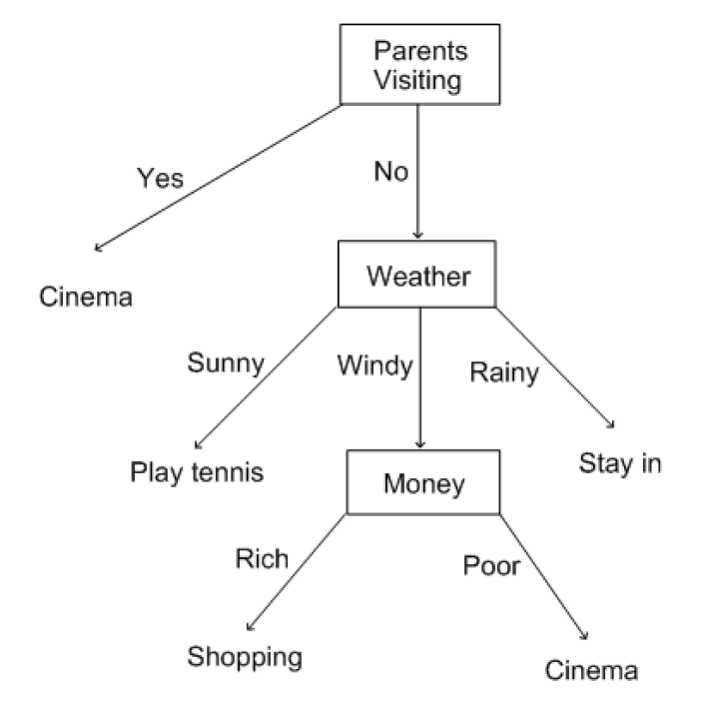
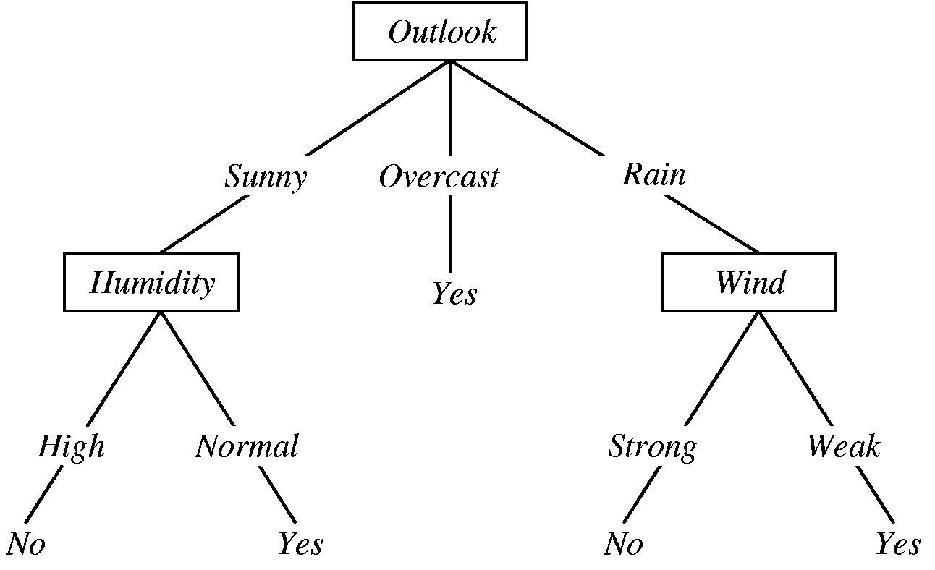
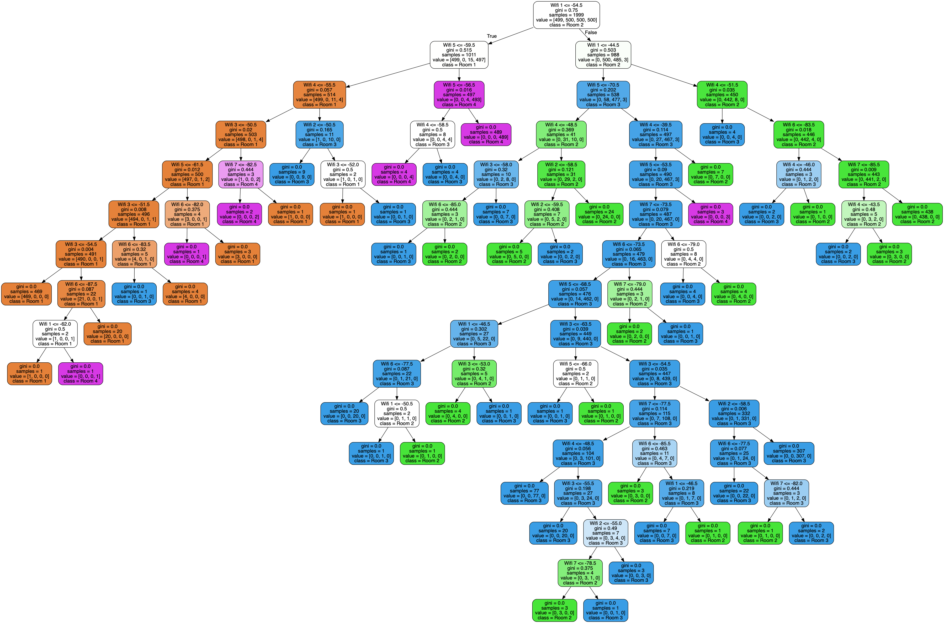
Decision Trees
Creating the Decision Tree
Executing the Decision Tree
What should I do this weekend?
Categorical
Will it Rain?
Categorical: Yes/No
Trees are often larger

Slide 9
Decision Trees
Creating the Decision Tree
Multiple algorithms
Splitting criteria
Most common based on Information Theory (Shannon)
Entropy-based splitting

Slide 10
Decision Trees
Entropy-based splitting
Given a binary categorization, C, and a set of examples, S, for which the proportion of examples categorized as positive by C is p₊, and the proportion of examples categorized as negative by C is p₋, then the entropy S is:
Characterizes the (im)purity of an arbitrary collection of examples
$$Entropy\left(S\right)=−p_{+}\log_{2}\left(p_{+}\right)−p_{−}\log_{2}(p_{−})$$

Slide 11
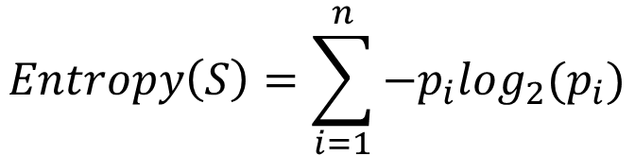
Decision Trees
For an arbitrary categorization of C into categories c₁, …., c_{n}
$$Entropy\left(S\right)=\sum_{i=1}^{n}{−p_{i}\log_{2}(p_{i})}$$

Slide 12
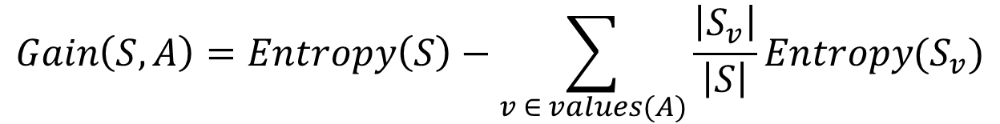
Decision Trees
The information gain of an attribute A, relative to a collection of examples, S, is calculated as:
$$Gain\left(S,A\right)=Entropy\left(S\right)−\sum_{v ∈ values(A)}{\frac{\left|S_{v}\right|}{\left|S\right|}Entropy(S_{v})}$$

Slide 13
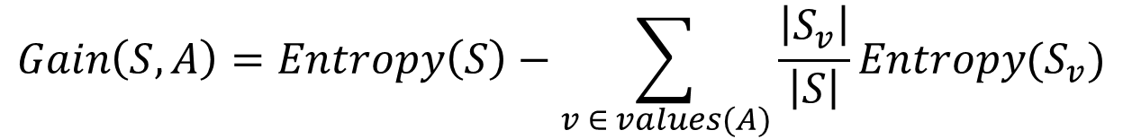
Decision Trees
$$Gain\left(S,A\right)=Entropy\left(S\right)−\sum_{v ∈ values(A)}{\frac{\left|S_{v}\right|}{\left|S\right|}Entropy(S_{v})}$$
Attribute A scores highest for Gain(S,A)
A
v
w
B
Attribute B scores highest for Gain(Sw,A)
Leaf node category c
y
x
Etc…

Slide 14
Decision Trees
Weekend | Weather | Parents | Money | Decision (Category)
W1 | Sunny | Yes | Rich | Cinema
W2 | Sunny | No | Rich | Tennis
W3 | Windy | Yes | Rich | Cinema
W4 | Rainy | Yes | Poor | Cinema
W5 | Rainy | No | Rich | Stay In
W6 | Rainy | Yes | Poor | Cinema
W7 | Windy | No | Poor | Cinema
W8 | Windy | No | Rich | Shopping
W9 | Windy | Yes | Rich | Cinema
W10 | Sunny | No | Rich | Tennis

Slide 15



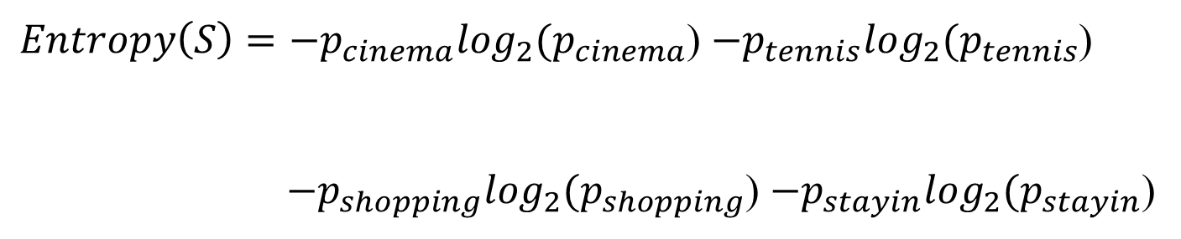

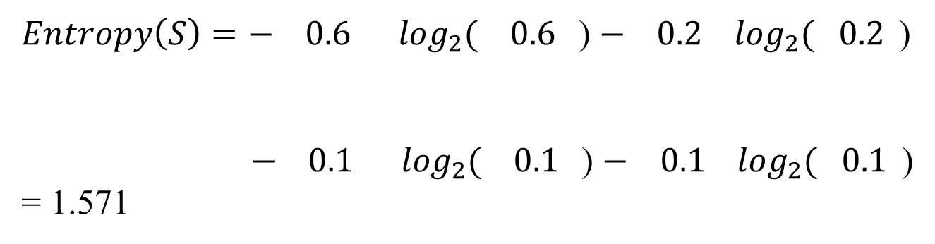




Decision Trees
Weekend | Weather | Parents | Money | Decision
W1 | Sunny | Yes | Rich | Cinema
W2 | Sunny | No | Rich | Tennis
W3 | Windy | Yes | Rich | Cinema
W4 | Rainy | Yes | Poor | Cinema
W5 | Rainy | No | Rich | Stay In
W6 | Rainy | Yes | Poor | Cinema
W7 | Windy | No | Poor | Cinema
W8 | Windy | No | Rich | Shopping
W9 | Windy | Yes | Rich | Cinema
W10 | Sunny | No | Rich | Tennis
$Entropy\left(S\right)={−p}_{cinema}\log_{2}(p_{cinema}$) ${−p}_{tennis}\log_{2}(p_{tennis}$)
${ −p}_{shopping}\log_{2}(p_{shopping}$) ${−p}_{stayin}\log_{2}(p_{stayin}$)
$Entropy\left(S\right)=− 0.6 \log_{2}( 0.6$) $− 0.2 \log_{2}( 0.2$)
$− 0.1 \log_{2}( 0.1$) $− 0.1 \log_{2}( 0.1$)
= 1.571
$$\frac{6}{10}$$
$$\frac{6}{10}$$
$$\frac{2}{10}$$
$$\frac{2}{10}$$
$$\frac{1}{10}$$
$$\frac{1}{10}$$
$$\frac{1}{10}$$
$$\frac{1}{10}$$

Slide 16
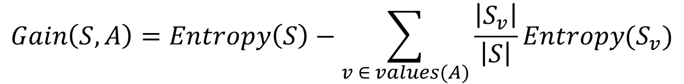
Decision Trees
Weekend | Weather | Parents | Money | Decision
W1 | Sunny | Yes | Rich | Cinema
W2 | Sunny | No | Rich | Tennis
W3 | Windy | Yes | Rich | Cinema
W4 | Rainy | Yes | Poor | Cinema
W5 | Rainy | No | Rich | Stay In
W6 | Rainy | Yes | Poor | Cinema
W7 | Windy | No | Poor | Cinema
W8 | Windy | No | Rich | Shopping
W9 | Windy | Yes | Rich | Cinema
W10 | Sunny | No | Rich | Tennis
Determine the best of:
Gain(S, weather), Gain(S, parents), Gain(S, money)
$$Gain\left(S,A\right)=Entropy\left(S\right)−\sum_{v ∈ values(A)}{\frac{\left|S_{v}\right|}{\left|S\right|}Entropy(S_{v})}$$

Slide 17
Decision Trees
Weekend | Weather | Parents | Money | Decision
W1 | Sunny | Yes | Rich | Cinema
W2 | Sunny | No | Rich | Tennis
W3 | Windy | Yes | Rich | Cinema
W4 | Rainy | Yes | Poor | Cinema
W5 | Rainy | No | Rich | Stay In
W6 | Rainy | Yes | Poor | Cinema
W7 | Windy | No | Poor | Cinema
W8 | Windy | No | Rich | Shopping
W9 | Windy | Yes | Rich | Cinema
W10 | Sunny | No | Rich | Tennis
Determine the best of:
Gain(S, weather)
Gain(S, parents)
Gain(S, money)
Weather
Sunny
Rainy
Windy

Slide 18
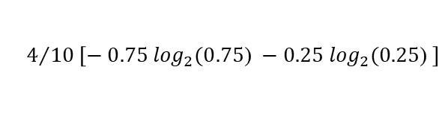

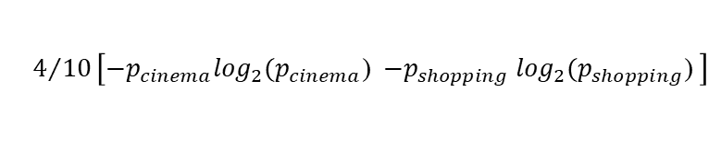
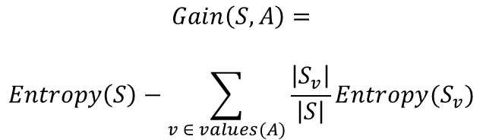

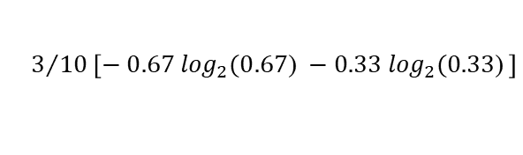
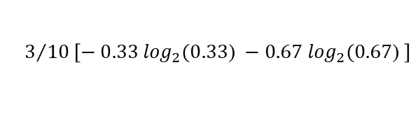
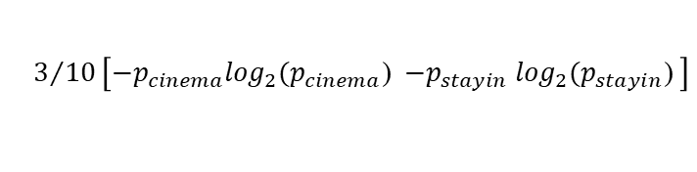
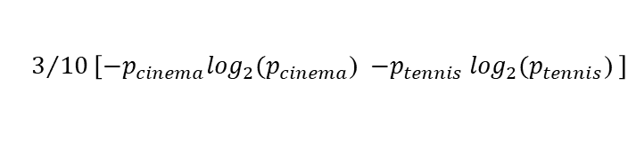

Decision Trees
1.571
$$Gain\left(S,A\right)=$$
$$Entropy\left(S\right)−\sum_{v ∈ values(A)}{\frac{\left|S_{v}\right|}{\left|S\right|}Entropy(S_{v})}$$
Weekend | Weather | Parents | Money | Decision
W1 | Sunny | Yes | Rich | Cinema
W2 | Sunny | No | Rich | Tennis
W3 | Windy | Yes | Rich | Cinema
W4 | Rainy | Yes | Poor | Cinema
W5 | Rainy | No | Rich | Stay In
W6 | Rainy | Yes | Poor | Cinema
W7 | Windy | No | Poor | Cinema
W8 | Windy | No | Rich | Shopping
W9 | Windy | Yes | Rich | Cinema
W10 | Sunny | No | Rich | Tennis
Sunny, Windy, Rainy
Sunny:
$$\frac{3}{10}Entropy(S_{v})$$
0.2755
$$3/{10}\left[{−p}_{cinema}\log_{2}(p_{cinema}\text{) }{−p}_{tennis}\log_{2}(p_{tennis}\text{) }\right]$$
$$3/{10}\left[− 0.33 \log_{2}(0.33\text{) }−0.67 \log_{2}(0.67\text{) }\right]$$
Windy:
$$\frac{4}{10}Entropy(S_{v})$$
0.3245
$$4/{10}\left[{−p}_{cinema}\log_{2}(p_{cinema}\text{) }{−p}_{shopping}\log_{2}(p_{shopping}\text{) }\right]$$
Weather
$$4/{10}\left[− 0.75 \log_{2}(0.75\text{) }−0.25 \log_{2}(0.25\text{) }\right]$$
Rainy
Sunny
Windy
Rainy:
$$\frac{3}{10}Entropy(S_{v})$$
0.2755
1.571-(0.2755+0.3245+0.2755)
= 0.70
$$3/{10}\left[{−p}_{cinema}\log_{2}(p_{cinema}\text{) }{−p}_{stayin}\log_{2}(p_{stayin}\text{)} \right]$$
$$3/{10}\left[− 0.67 \log_{2}(0.67\text{) }−0.33 \log_{2}(0.33\text{)} \right]$$

Slide 19
Decision Trees
Weekend | Weather | Parents | Money | Decision
W1 | Sunny | Yes | Rich | Cinema
W2 | Sunny | No | Rich | Tennis
W3 | Windy | Yes | Rich | Cinema
W4 | Rainy | Yes | Poor | Cinema
W5 | Rainy | No | Rich | Stay In
W6 | Rainy | Yes | Poor | Cinema
W7 | Windy | No | Poor | Cinema
W8 | Windy | No | Rich | Shopping
W9 | Windy | Yes | Rich | Cinema
W10 | Sunny | No | Rich | Tennis
Determine the best of:
Gain(S, weather) = 0.70
Gain(S, parents) = 0.61
Gain(S, money) = 0.2816
Weather
Sunny
Rainy
Windy

Slide 20
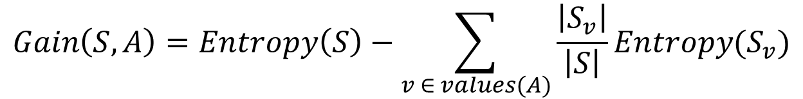
Decision Trees
Weekend | Weather | Parents | Money | Decision
W1 | Sunny | Yes | Rich | Cinema
W2 | Sunny | No | Rich | Tennis
W10 | Sunny | No | Rich | Tennis
Weather
Sunny
Rainy
Windy
?
Determine the best of:
Gain(S_{sunny}, parents) and Gain(S_{sunny}, money)
$$Gain\left(S,A\right)=Entropy\left(S\right)−\sum_{v ∈ values(A)}{\frac{\left|S_{v}\right|}{\left|S\right|}Entropy(S_{v})}$$

Slide 21
Decision Trees
Weekend | Weather | Parents | Money | Decision
W1 | Sunny | Yes | Rich | Cinema
W2 | Sunny | No | Rich | Tennis
W10 | Sunny | No | Rich | Tennis
Weather
Sunny
Rainy
Windy
?
Determine the best of:
Gain(S_{sunny}, parents) = 0.918
Gain(S_{sunny}, money) = 0

Slide 22
Decision Trees
Weekend | Weather | Parents | Money | Decision
W1 | Sunny | Yes | Rich | Cinema
W2 | Sunny | No | Rich | Tennis
W10 | Sunny | No | Rich | Tennis
Weather
Sunny
Rainy
Windy
Parents
yes
no
Cinema
Tennis
Determine the best of:
Gain(S_{sunny}, parents) = 0.918
Gain(S_{sunny}, money) = 0

Slide 23
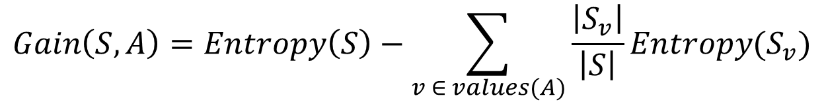
Decision Trees
Weekend | Weather | Parents | Money | Decision
W3 | Windy | Yes | Rich | Cinema
W7 | Windy | No | Poor | Cinema
W8 | Windy | No | Rich | Shopping
W9 | Windy | Yes | Rich | Cinema
Weather
Sunny
Rainy
Windy
Parents
?
yes
no
Cinema
Tennis
Determine the best of: Gain(S_{windy}, parents) and Gain(S_{windy}, money)
$$Gain\left(S,A\right)=Entropy\left(S\right)−\sum_{v ∈ values(A)}{\frac{\left|S_{v}\right|}{\left|S\right|}Entropy(S_{v})}$$

Slide 24
Decision Trees
Weekend | Weather | Parents | Money | Decision
W3 | Windy | Yes | Rich | Cinema
W7 | Windy | No | Poor | Cinema
W8 | Windy | No | Rich | Shopping
W9 | Windy | Yes | Rich | Cinema
Weather
Sunny
Rainy
Windy
Parents
Parents
yes
no
yes
no
Cinema
Tennis
Cinema
Money
Determine the best of:
Gain(S_{windy}, parents) = .3113
Gain(S_{windy}, money) = .1226
poor
rich
Cinema
Shopping

Slide 25
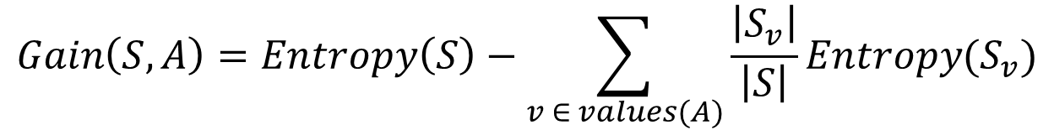
Decision Trees
Weekend | Weather | Parents | Money | Decision
W4 | Rainy | Yes | Poor | Cinema
W5 | Rainy | No | Rich | Stay In
W6 | Rainy | Yes | Poor | Cinema
Determine the best of:
Gain(S_{rainy}, parents)
Gain(S_{rainy}, money)
Weather
Sunny
Rainy
Windy
Parents
?
Parents
yes
no
yes
no
Cinema
Tennis
Cinema
Money
poor
rich
Cinema
Shopping
$$Gain\left(S,A\right)=Entropy\left(S\right)−\sum_{v ∈ values(A)}{\frac{\left|S_{v}\right|}{\left|S\right|}Entropy(S_{v})}$$

Slide 26
Decision Trees
Weekend | Weather | Parents | Money | Decision
W4 | Rainy | Yes | Poor | Cinema
W5 | Rainy | No | Rich | Stay In
W6 | Rainy | Yes | Poor | Cinema
Weather
Sunny
Rainy
Windy
Parents
Parents
Parents
yes
no
yes
no
yes
no
Cinema
Tennis
Cinema
Money
Cinema
Stay In
Determine the best of:
Gain(S_{rainy}, parents) = .9183
Gain(S_{rainy}, money) = .9183
poor
rich
Cinema
Shopping

Slide 27
Decision Trees
Weekend | Weather | Parents | Money | Decision
W4 | Rainy | Yes | Poor | Cinema
W5 | Rainy | No | Rich | Stay In
W6 | Rainy | Yes | Poor | Cinema
Weather
Sunny
Rainy
Windy
Parents
Parents
Money
yes
no
yes
no
poor
rich
Cinema
Tennis
Cinema
Money
Cinema
Stay In
Determine the best of:
Gain(S_{rainy}, parents) = .9183
Gain(S_{rainy}, money) = .9183
poor
rich
Cinema
Shopping

Slide 28
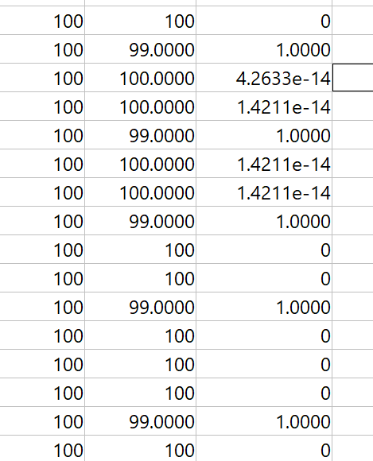
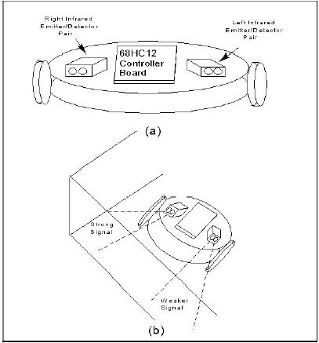
Designing a Robot (Example)
Drive robot around with human decisions and collect the data (Training Data)
Left Sensor, Right Sensor, Turn angle

Slide 29
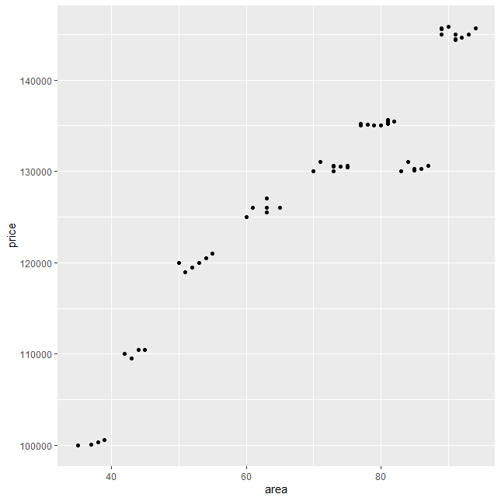
Regression Trees
For creating decision trees that have continuous valued results rather than categorical
Example: 2-D dataset of annual rental costs of office space in central New York City

Slide 30
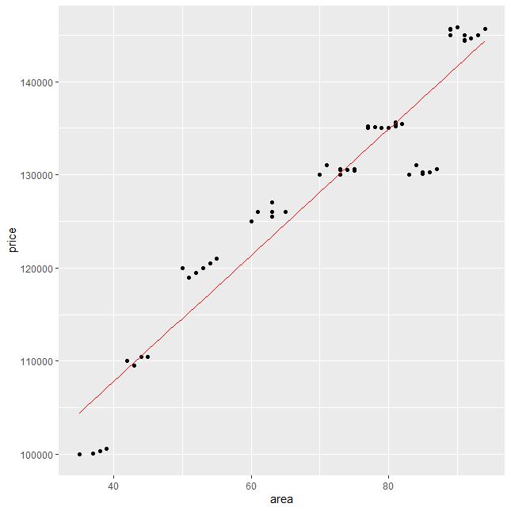
Regression Trees
Linear Fit – least squares regression

Slide 31
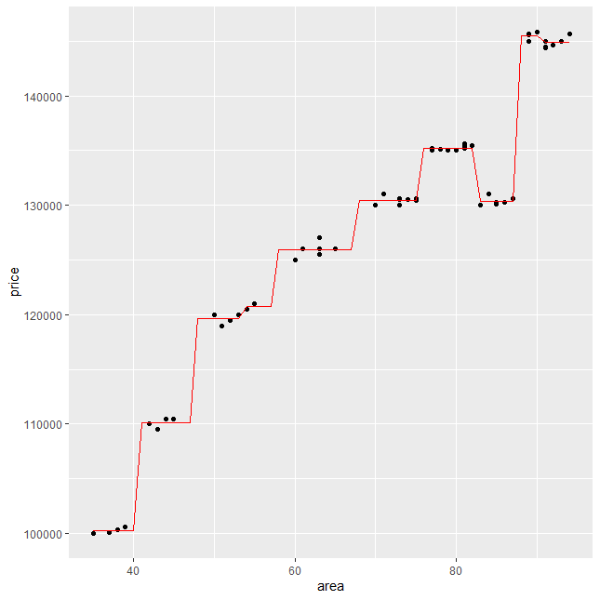
Regression Trees
Regression Trees (decision tree with continuous output)

Slide 32
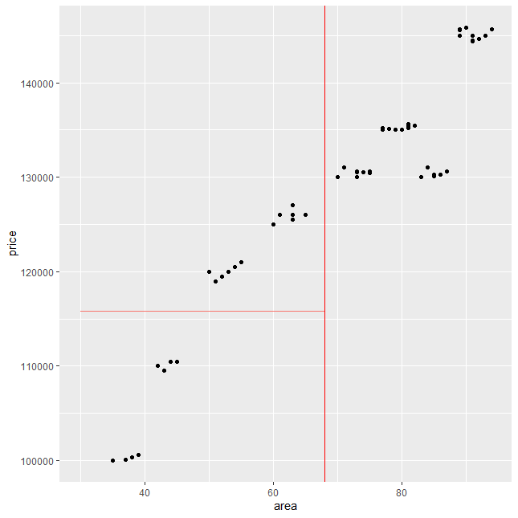
Regression Trees
If we guessed a split at 68 sq. ft, the average price of all those to the left (below) is shown in red
Not a good split
$115,844

Slide 33
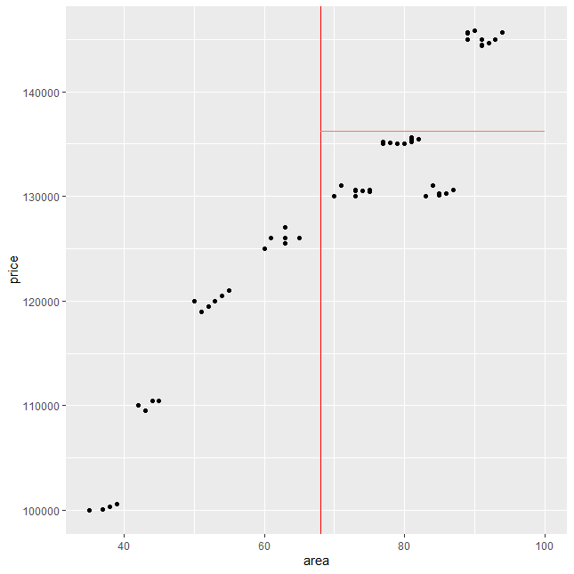
Regression Trees
If we guessed a split at 68 sq. ft, the average price of all those to the right (above) is shown in red
Total error is the sum or all error over all points
$136,215

Slide 34
Regression Trees
Area
<68
>=68
$115,844
$136,215
This would be the one-split tree, resulting in high error

Slide 35
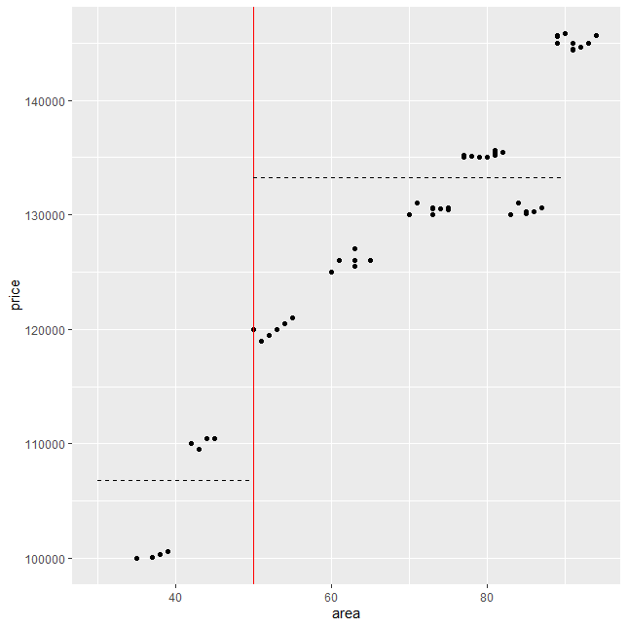
Regression Trees
Iterate through all possible splits (sq. ft) and calculate the total error.
We are looking for the split with the least total error
Absolute error
Squared error
An iteration of searching for an optimal split

Slide 36
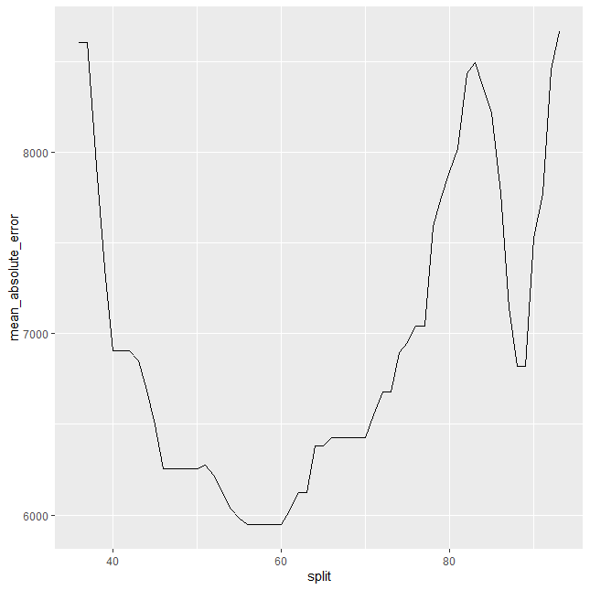
Regression Trees
Between 55 and 59 produce optimal results
Error as a function of each possible split

Slide 37
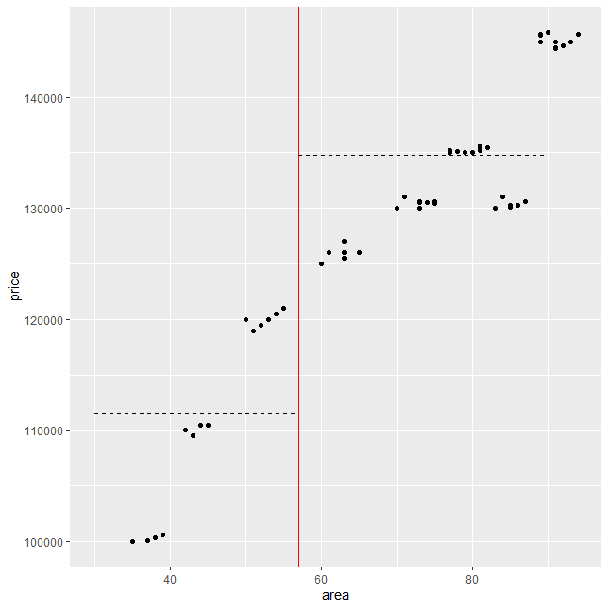
Regression Trees
Area
<57
>=57
$111,528
$134,778
Optimal Split and the predicted results

Slide 38
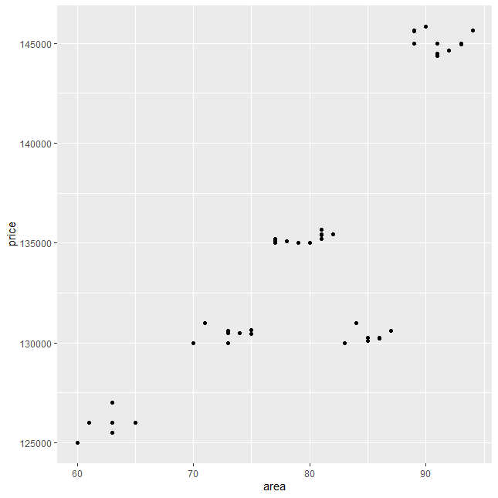
Regression Trees
Area
<57
>=57
$111,528
Area
?
?
Split further – area >= 57

Slide 39
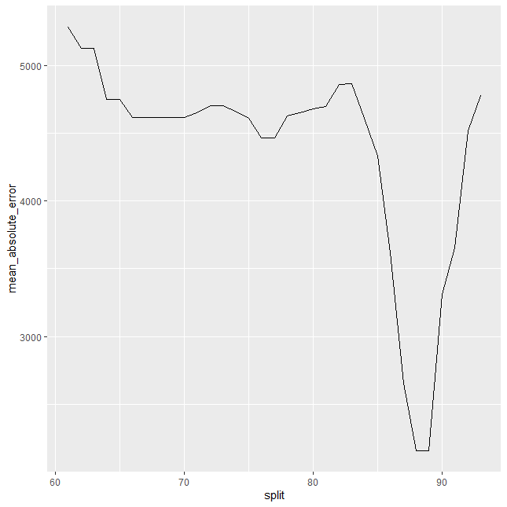
Regression Trees
Between 88 and 89 produce optimal results
Error as a function of each possible split

Slide 40
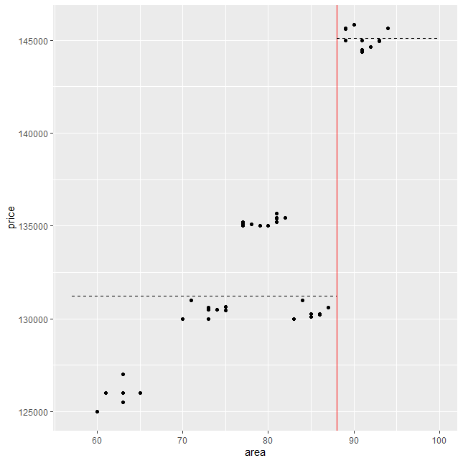
Regression Trees
Area
<57
>=57
$111,528
Area
<88.5
>=88.5
$131,226
$145,110

Slide 41
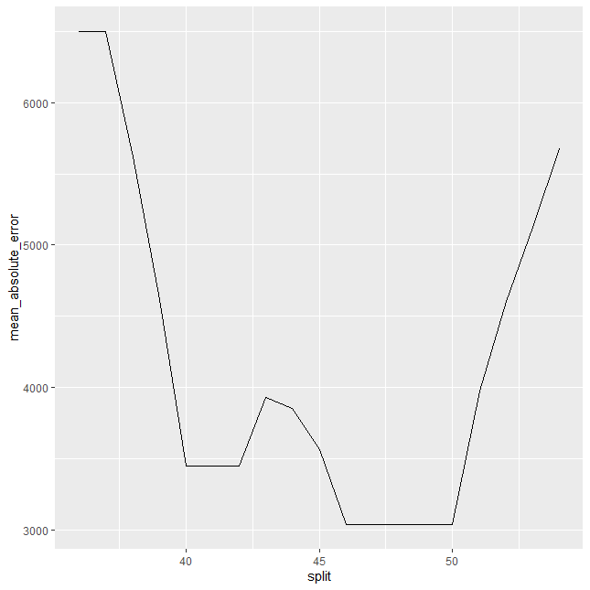
Regression Trees
Between 47 and 50 produce optimal results
Area
<57
>=57
Area
Area
?
?
<88.5
>=88.5
$131,226
$145,110
Split further – area < 57

Slide 42
Regression Trees
Area
<57
>=57
Area
Area
<48.5
>=48.5
<88.5
>=88.5
$105,174
$120,000
$131,226
$145,110

Slide 43
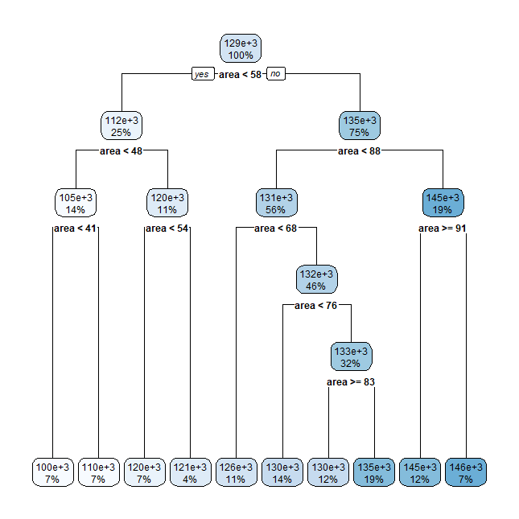
Regression Trees

Slide 44

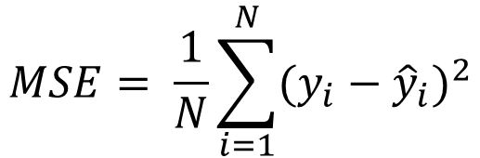
Regression Trees
When do you stop splitting to avoid over-fitting?
Max Depth – max depth of the tree
Min Split – minimum in a node for a split to occur
Min Bucket – minimum in any terminal leaf
Max Splits – maximum number of splits total
Error rate target
Complexity Factor – related to size of tree overall
Evaluate error of the regression tree
Mean-Squared Error (MSE)
Root-mean-squared (RMS)
Most closely related to units from input data
$$MSE= \frac{1}{N}\sum_{i=1}^{N}{{(y_{i}−{\hat{y}}_{i})}^{2}}$$
$$RMS= \sqrt{MSE}$$

Slide 45
Regression Trees
Multi-dimensional data
n-dimensional Data
Splits must minimize total error over all dimensions
More computationally intense
Once tree is designed, executing it is IF-Statements and comparisons
Techniques to update the tree if further learning is desired
Open-loop - operation
Closed-loop – operation and learning

Slide 46
Regression Trees
Once tree is designed, executing it is IF-Statements and comparisons
Nanosecond execution times on Arduino Mega2560 (16 MHz)
Operation | uint8 | int16 | int32 | int64 | float
+ | 63 | 884 | 1763 | 8428 | 10943
* | 125 | 1449 | 4592 | 57038 | 10422
/ | 15859 | 15969 | 41866 | 274809 | 31951
sqrt |  |  | 54448 | 70884 | 47127
Clock Cycles on Arduino Mega2560 (16 M CC/s * T/1000)
Operation | uint8 | int16 | int32 | int64 | float
+ | 1 | 14 | 28 | 135 | 175
* | 2 | 23 | 73 | 913 | 167
/ | 254 | 256 | 670 | 4397 | 511
sqrt | 0 | 0 | 871 | 1134 | 754

Slide 47
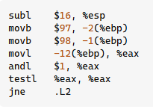

Regression Trees
Once tree is designed, executing it is IF-Statements and comparisons
On a i386 architecture and with gcc the assembly code produced:
int d;
char ch1;
char ch2;
cin>>ch1>>ch2;
if((d&1) == 0) {
//heavy computation
}
if(ch1 == ch2){
//heavy computation
}
Inst Type | # Inst | CC / Inst | Total
Int Arith/Logic | 3 | 1 | 3
Data Transfer | 3 | 2 | 6
Control Transfer | 1 | 2 | 2
7 CC
11 CC
Clock Cycles on Arduino Mega2560 (16 M CC/s * T/1000)
Operation | uint8 | int16 | int32 | int64 | float
+ | 1 | 14 | 28 | 135 | 175
* | 2 | 23 | 73 | 913 | 167
/ | 254 | 256 | 670 | 4397 | 511
sqrt | 0 | 0 | 871 | 1134 | 754

Slide 48
Cross-Validation
Measure of Stability
Compare error for single tree with a cross-validation process
Leave-one-out Method
Leave one out of training, for testing
If you had 100 data points, for example, you would have 100 trees created where each has an error rate from leaving one out.
K-fold
K = 10, for example, means 10% of the data are used for testing. For example, if you have 100 data points, 90 would be used for training and 10 would be used for testing. In this example, you would have 10 trees created.

